Slide 1

Measuring the Geographic Distribution of Postsecondary Opportunity: The Role of Branch Campuses
Coral Flanagan
Notes:
CORAL

Slide 2
Motivation and Research Questions
Research demonstrates that proximity to postsecondary institutions is linked to increased attainment (Card, 1991; Doyle & Skinner, 2016; Rouse, 1995).
However, access to postsecondary institutions is not distributed equally; rural, low-income and communities of color all offer fewer options (Hillman, 2016).
Existing research on the distribution of postsecondary opportunity largely ignores the role of branch campuses (Bird, 2014).
Research Question: How does including branch campus locations change measures of the geographic distribution of postsecondary opportunity?
Notes:
CORAL
Could do this as a graphic instead:
Federal policy requires schools to identify students with limited English proficiency and provide them with supports to access a “meaningful” education (Dear Colleague Letter, 2015)
The process of identifying which students should receive ELs services and determining when students should be exited from EL status is highly consequential for students’ educational experiences.

Slide 3
Data
Integrated Postsecondary Education Data System (IPEDS) (2019): All US colleges, universities, and technical institutions that participate in federal student aid programs. Includes some but not all branch campuses.
Postsecondary Education Participants Systems (PEPS) (2022): All US college, universities, and technical institutions that participate in federal student aid and other Higher Education Act programs. Much more comprehensive report of campus locations.
Analysis is limited to public institutions

Slide 4
Data
Dataset | Total Observations | Total Observations in TN | Percent Institutions Part of Multi-Campus
IPEDS | 1755 | 49 | 9%
Notes:
Example: Chattanooga State Community College is one location in IPEDS and 4 in PEPS; Dybersburg is one location in IPEDS and 6 in PEPS

Slide 5
Data
Dataset | Total Observations | Total Observations in TN | Percent Institutions Part of Multi-Campus
IPEDS | 1755 | 49 | 9%
PEPS | 7015 | 235 | 94%
Notes:
Example: Chattanooga State Community College is one location in IPEDS and 4 in PEPS; Dybersburg is one location in IPEDS and 6 in PEPS

Slide 6
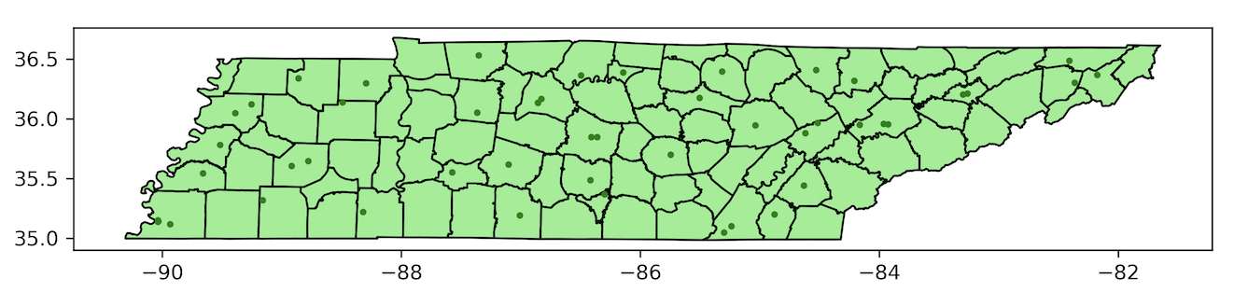
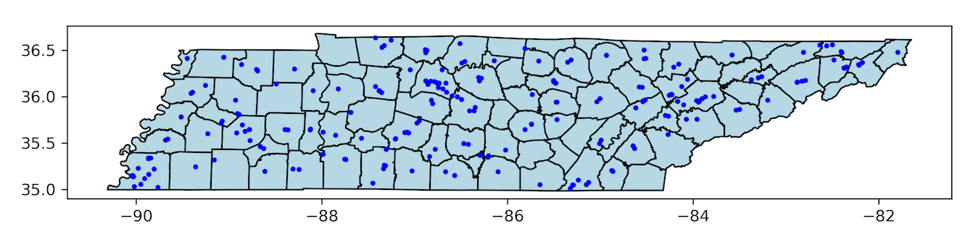
Analysis: Distribution of Postsecondary Opportunity in TN
IPEDs Dataset
PEPS Dataset

Slide 7
Measures of Opportunity Are Different with Inclusion of Branch Campuses
Postsecondary Opportunity in Tennessee
Dataset | Average Distance (Miles) | Median Distance | Minimum Distance | County with Minimum Distance | Maximum Distance | County with Maximum Distance
IPEDS | 8.54 | 7.71 | 0.59 | Hamilton | 21.91 | Knox

Slide 8
Measures of Opportunity Are Different with Inclusion of Branch Campuses
Postsecondary Opportunity in Tennessee
Dataset | Average Distance (Miles) | Median Distance | Minimum Distance | County with Minimum Distance | Maximum Distance | County with Maximum Distance
IPEDS | 8.54 | 7.71 | 0.59 | Hamilton | 21.91 | Knox

Slide 9
Measures of Opportunity Are Different with Inclusion of Branch Campuses
Postsecondary Opportunity in Tennessee
Dataset | Average Distance (Miles) | Median Distance | Minimum Distance | County with Minimum Distance | Maximum Distance | County with Maximum Distance
IPEDS | 8.54 | 7.71 | 0.59 | Hamilton | 21.91 | Knox

Slide 10
Measures of Opportunity Are Different with Inclusion of Branch Campuses
Postsecondary Opportunity in Tennessee
Dataset | Average Distance (Miles) | Median Distance | Minimum Distance | County with Minimum Distance | Maximum Distance | County with Maximum Distance
IPEDS | 8.54 | 7.71 | 0.59 | Hamilton | 21.91 | Knox

Slide 11
Measures of Opportunity Are Different with Inclusion of Branch Campuses
Postsecondary Opportunity in Tennessee
Dataset | Average Distance (Miles) | Median Distance | Minimum Distance | County with Minimum Distance | Maximum Distance | County with Maximum Distance
IPEDS | 8.54 | 7.71 | 0.59 | Hamilton | 21.91 | Knox

Slide 12
Measures of Opportunity Are Different with Inclusion of Branch Campuses
Dataset | Average Distance | Median Distance | Minimum Distance | County with Minimum Distance | Maximum Distance | County with Maximum Distance
IPEDS | 8.54 | 7.71 | 0.59 | Hamilton | 21.91 | Knox
PEPS | 9.55 | 8.77 | 0.32 | Hamblen | 31.17 | Hawkins

Slide 13
Measures of Opportunity Are Different with Inclusion of Branch Campuses
Dataset | Average Distance | Median Distance | Minimum Distance | County with Minimum Distance | Maximum Distance | County with Maximum Distance
IPEDS | 8.54 | 7.71 | 0.59 | Hamilton | 21.91 | Knox
PEPS | 9.55 | 8.77 | 0.32 | Hamblen | 31.17 | Hawkins

Slide 14
Measures of Opportunity Are Different with Inclusion of Branch Campuses
Dataset | Average Distance | Median Distance | Minimum Distance | County with Minimum Distance | Maximum Distance | County with Maximum Distance
IPEDS | 8.54 | 7.71 | 0.59 | Hamilton | 21.91 | Knox
PEPS | 9.55 | 8.77 | 0.32 | Hamblen | 31.17 | Hawkins

Slide 15
Measures of Opportunity Are Different with Inclusion of Branch Campuses
Dataset | Average Distance | Median Distance | Minimum Distance | County with Minimum Distance | Maximum Distance | County with Maximum Distance
IPEDS | 8.54 | 7.71 | 0.59 | Hamilton | 21.91 | Knox
PEPS | 9.55 | 8.77 | 0.32 | Hamblen | 31.17 | Hawkins

Slide 16
Takeaway
Branch campuses are an important part of measuring geographic opportunity and should be included to more accurately identify areas of low and high opportunity.

